Slide 1
PLACEMENT MANAGEMENT SYSTEM
Team members:
Bhanupriya C G PES1201701742
Melavoy Thanusha Sai PES1201701457
V Nayana PES1201701580
Akshatha N K PES1201701531

Slide 2
INTRODUCTION:
The Placement Management System is developed as an attempt to take a record of company and students by restricting such a large database to that of a particular class of students or company.
Now a days campus placements are conducted in all colleges. Various software and other sector companies are conducting campus selections for selecting merit candidates.
When campus selection are conducted the students should provide their curriculum vitae to the concerned officer for attending the campus interviews. This routine process is maintained manually, like maintenance of their resumes in papers. This can be automated by designing a software.

Slide 3
Proposed system and its merits:
The proposed system is fully computerized, which removes all the drawbacks of the earlier system. Proposed system is an online application that can be accessed throughout the organization and outside as well with proper login provided.
Improve student placement and retention.
Streamline placement tasks and save time.
Schedule interview and responsibility details.
Administrative control over students and companies.
Identify companies that match student’s expectations.
Automation: The application automatically notifies about upcoming companies.
Online portal: Students can apply for company online.
Highly secure and reliable.
Admin can send required materials used for placements preparation to students. With this option preparation for placements become easy.

Slide 4
Student module
First the student has to register. Only registered students will login by username and password
The dashboard will display all the contents of the student information.
There we can see the companies visiting the campus and for which that student can apply
Update details: This service provides the user to update their details.
Change password: this service enables the users to change the password.

Slide 5
Admin module:
Admin has to login to check the details of the students and about all the companies visiting the campus and their criteria. There he can also provide the details of all the eligible students to the companies and the details and expectations of the company to the students.

Slide 6
Company module:
Here first the company has to login with its username and password to get the details about students and check whom they can take. Here they can also check how many students are selected for that particular company.

Slide 7
Conclusion:
Placements play a role in improving student satisfaction in general, and in aiding healthy retention and achievement rates. High-quality placements can improve a university’s broader engagement and relationships with business.
The new placement management system can be used by colleges to maintain the student information with regards to placement details.
Placements give students the opportunity to gain skills specific to their subject or industry of choice as well as the employability skills required for real-life work.
It also increase their knowledge of an industry or sector, allowing them about future career choices.

Slide 8
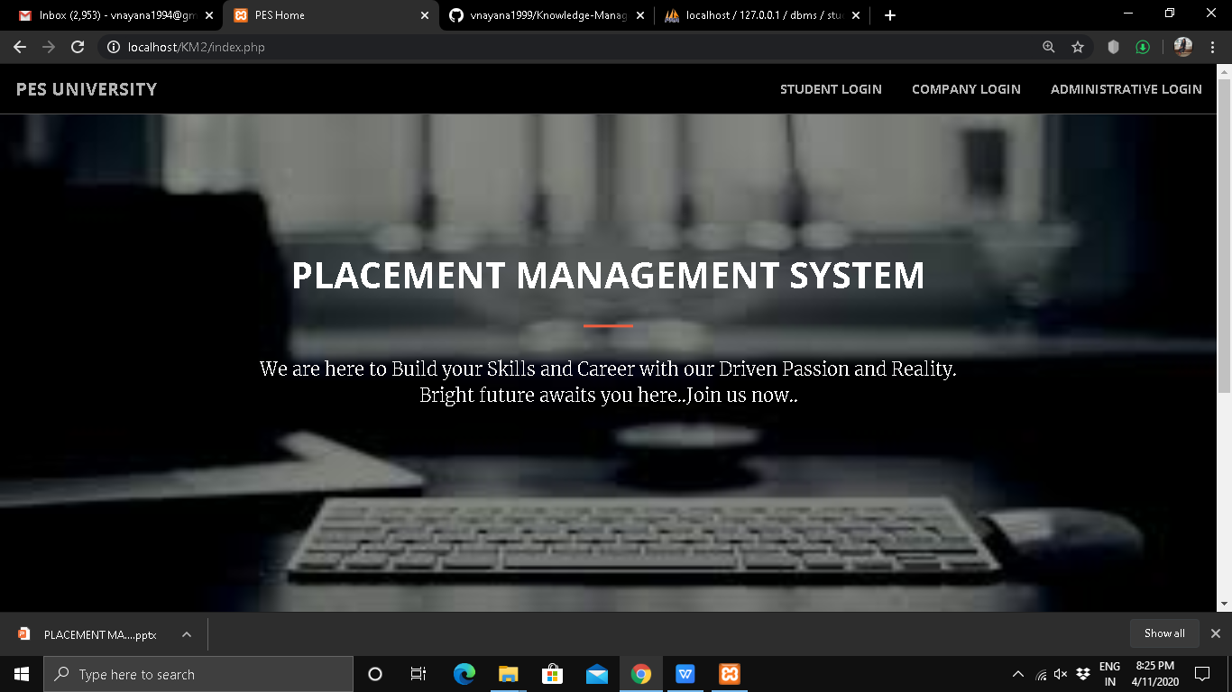
SCREENSHOTS

Slide 9
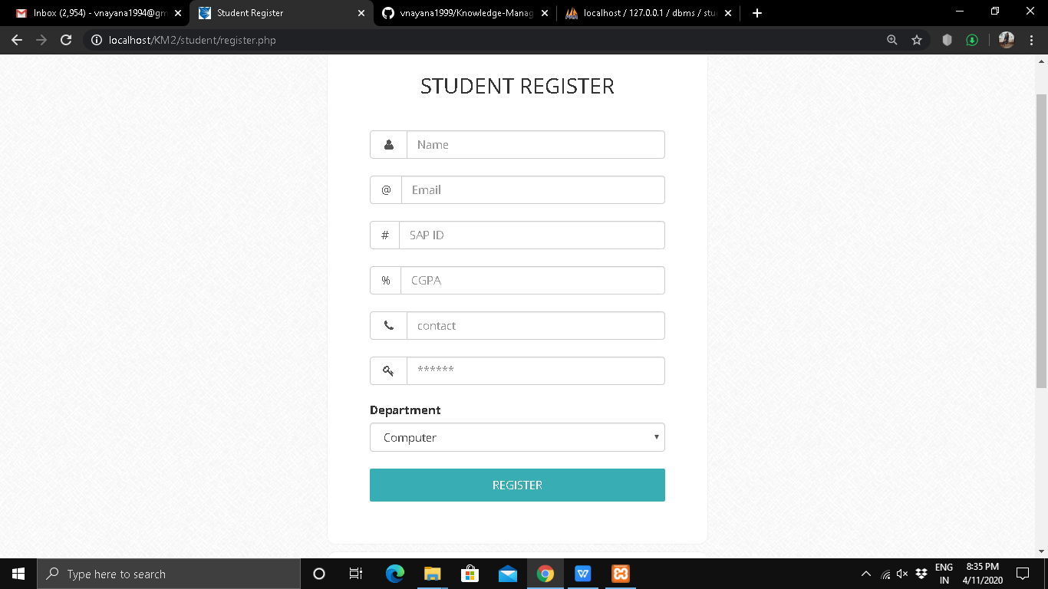

Slide 10
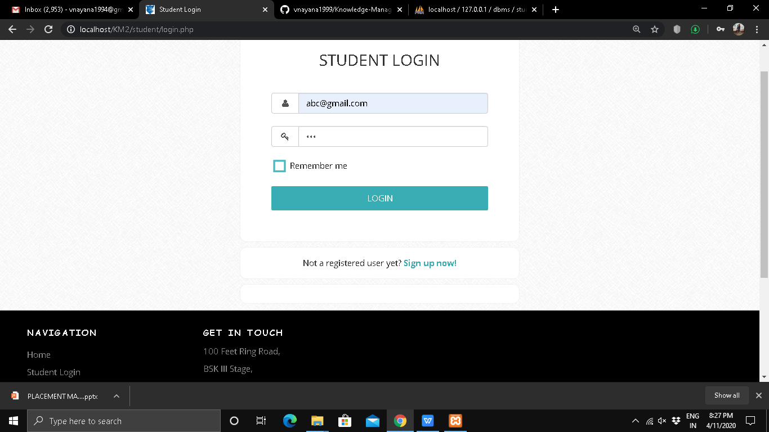

Slide 11
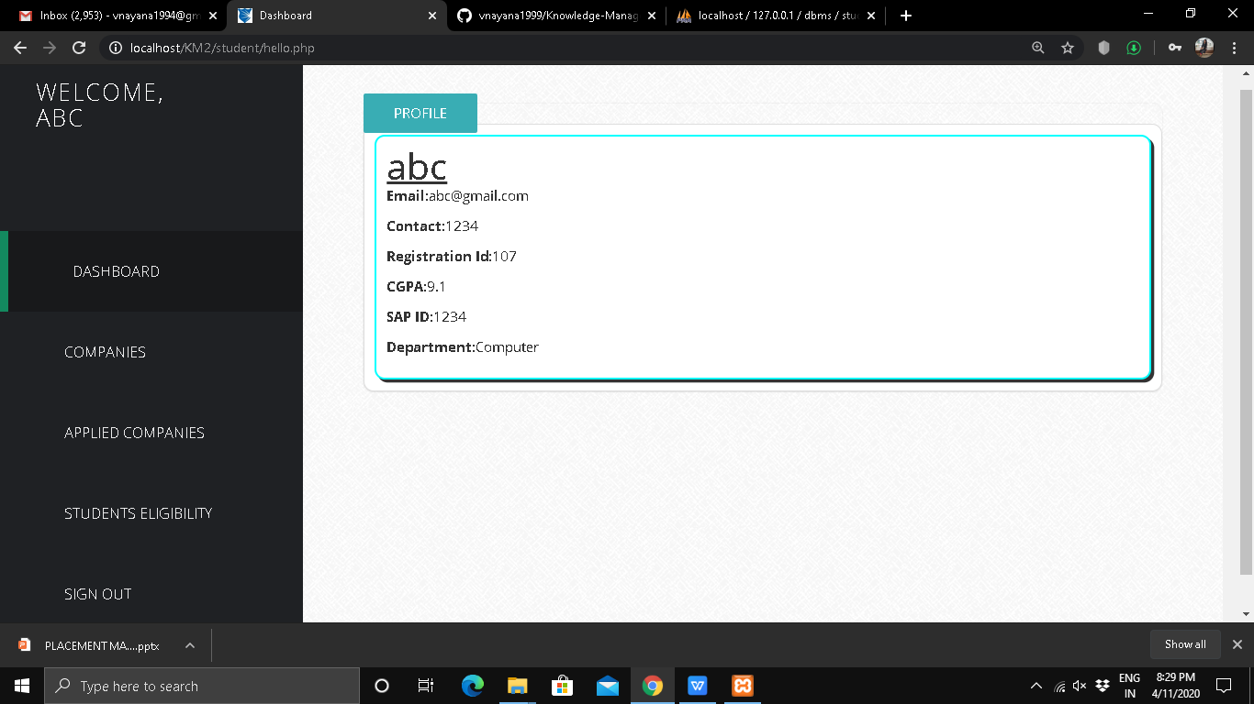

Slide 12
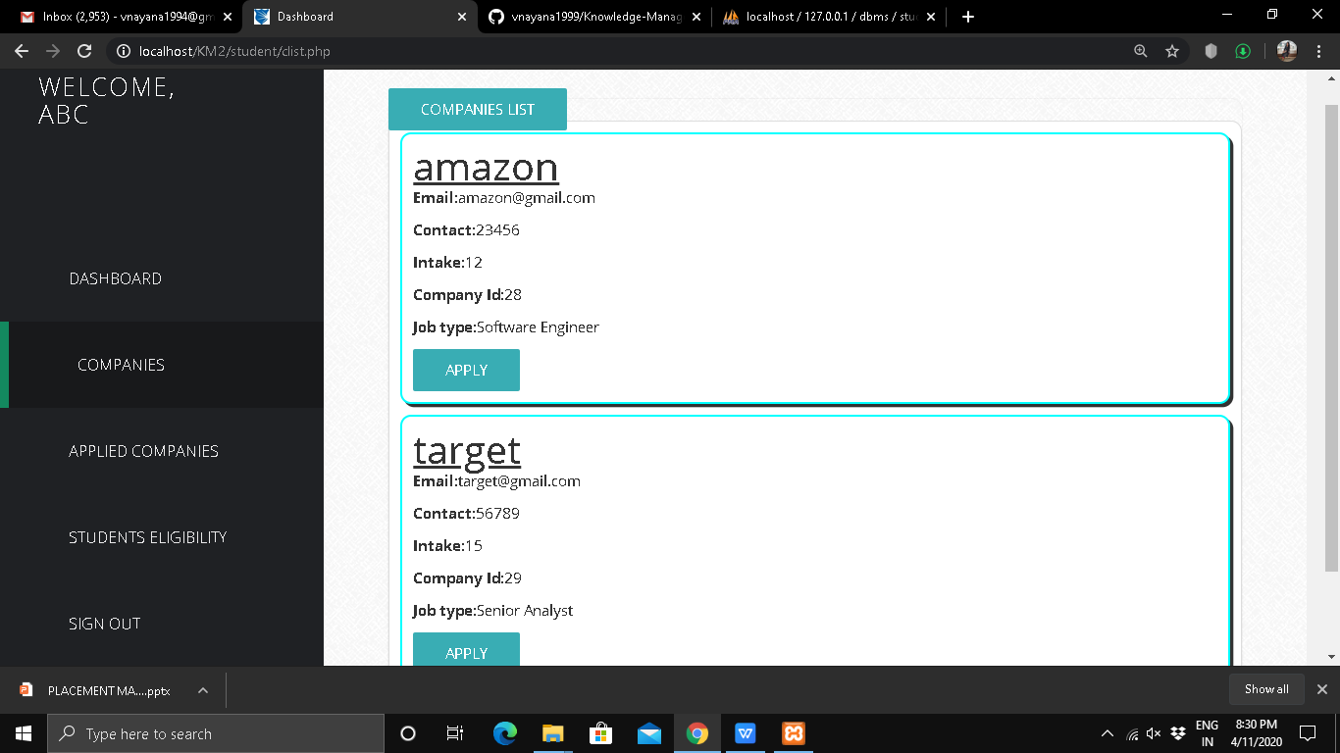

Slide 13
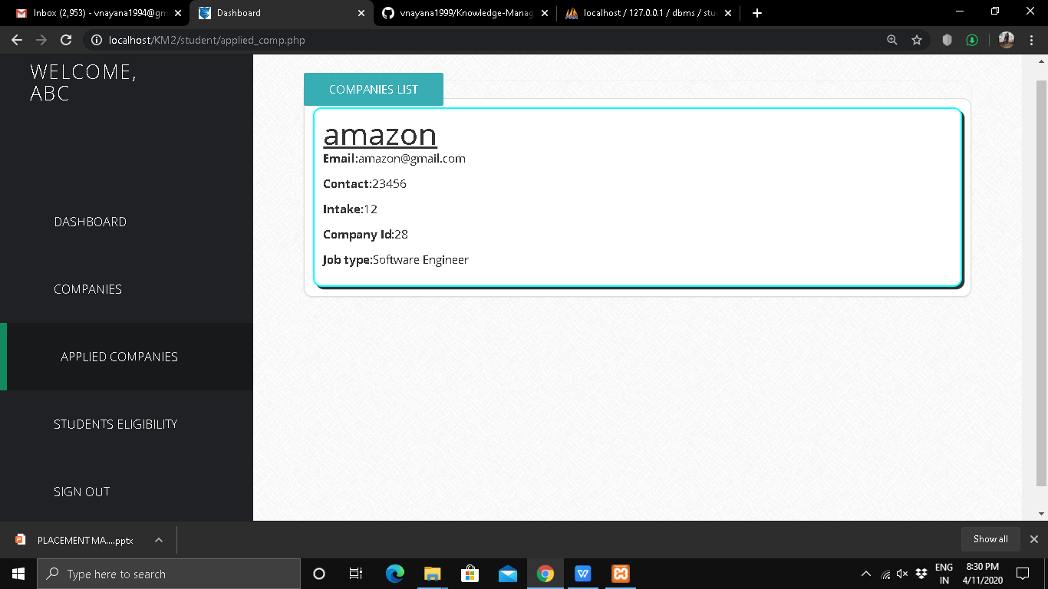

Slide 14
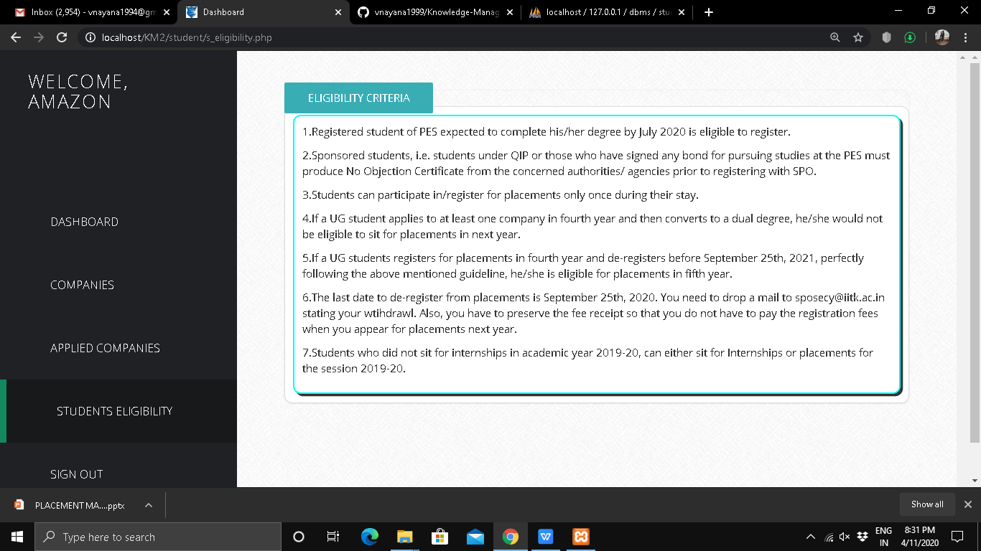

Slide 15
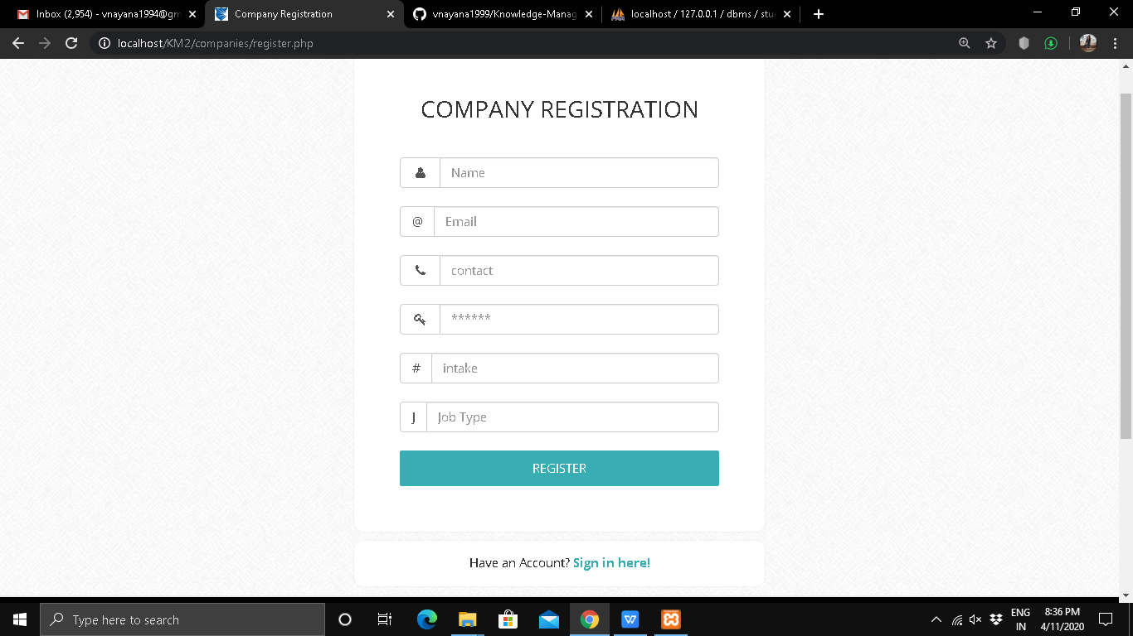

Slide 16
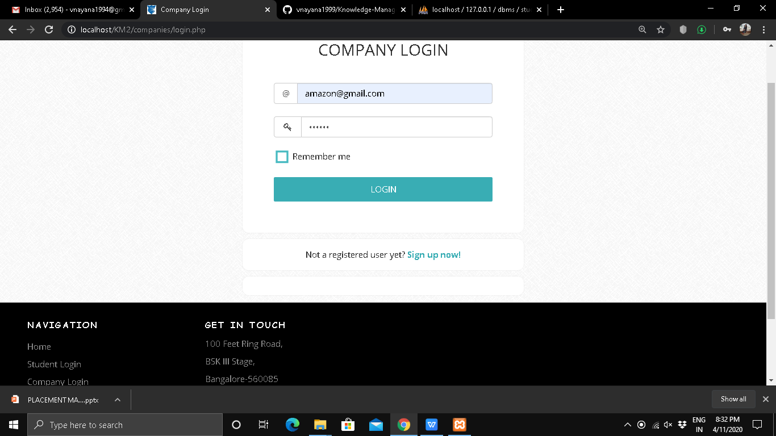

Slide 17
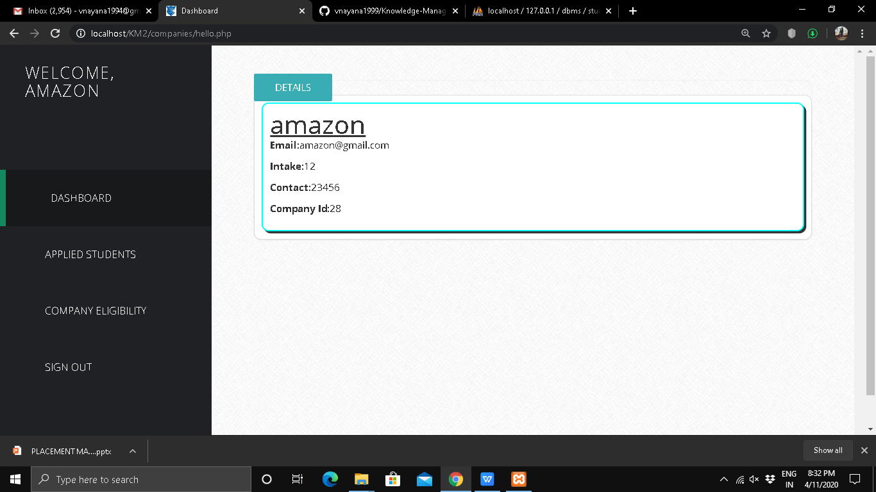

Slide 18
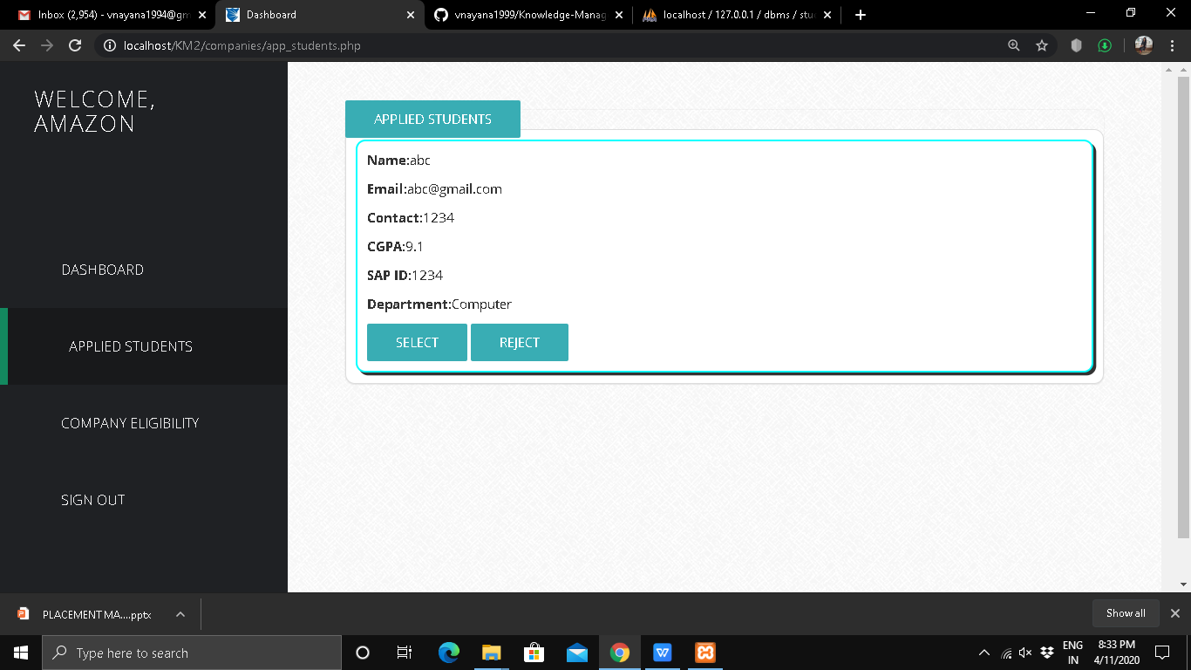

Slide 19
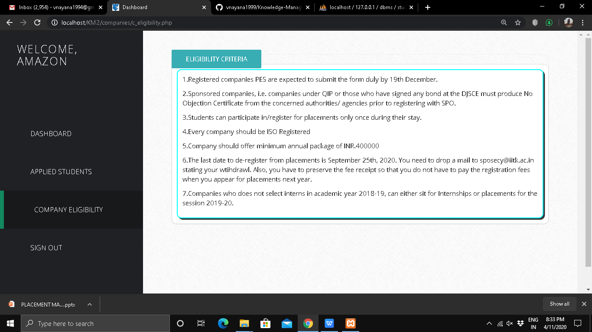

Slide 20
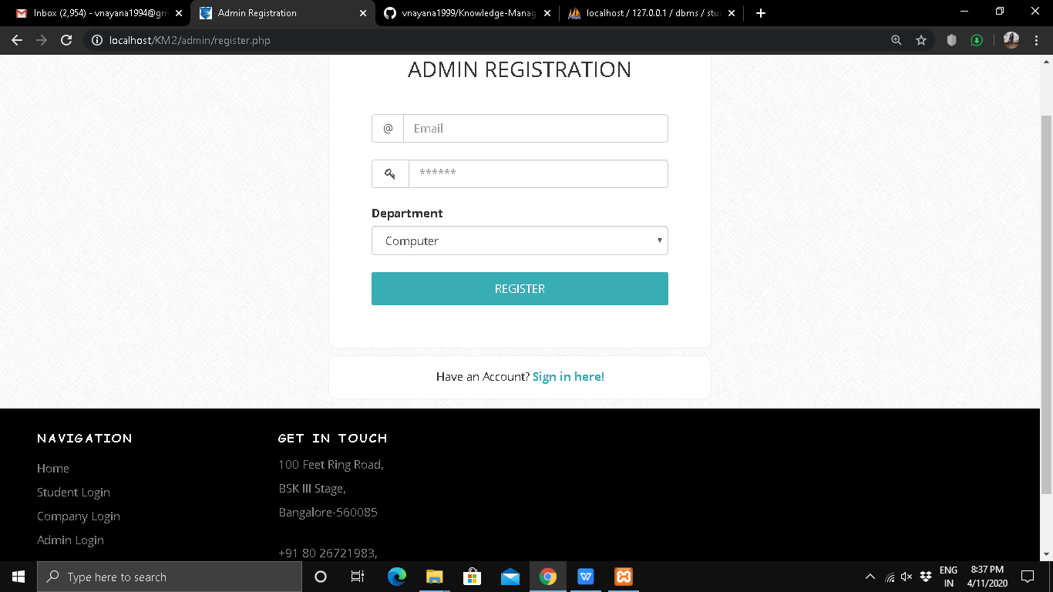

Slide 21
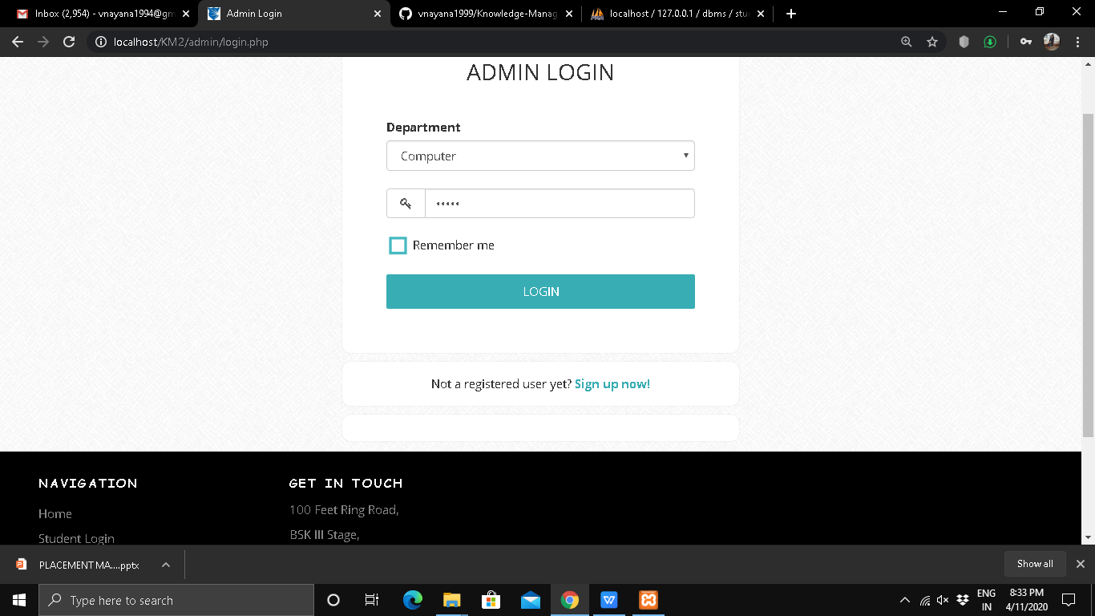

Slide 22
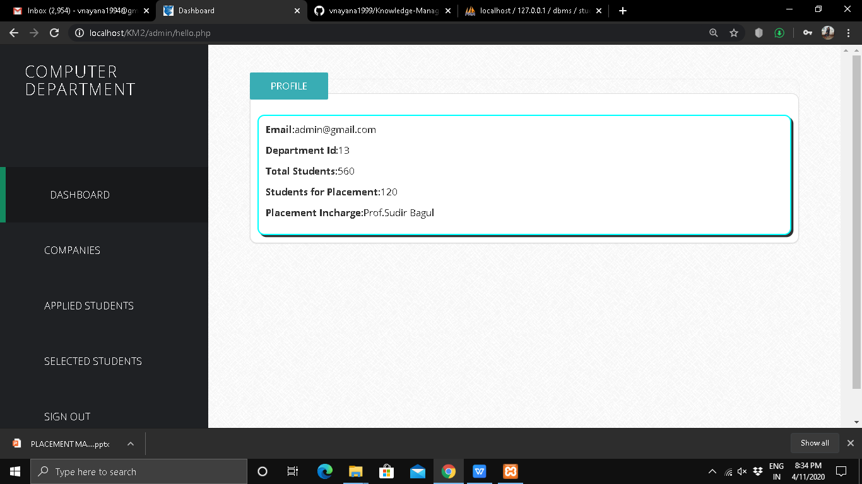

Slide 23
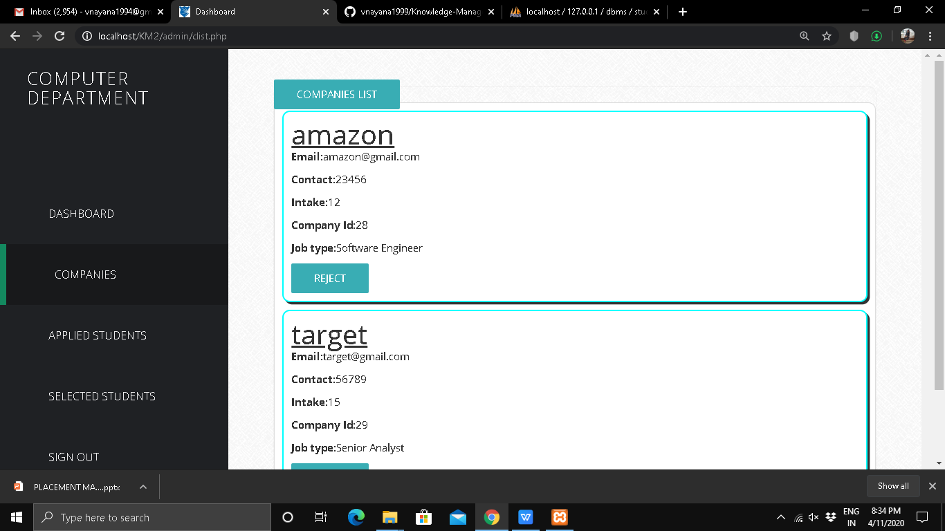

Slide 24
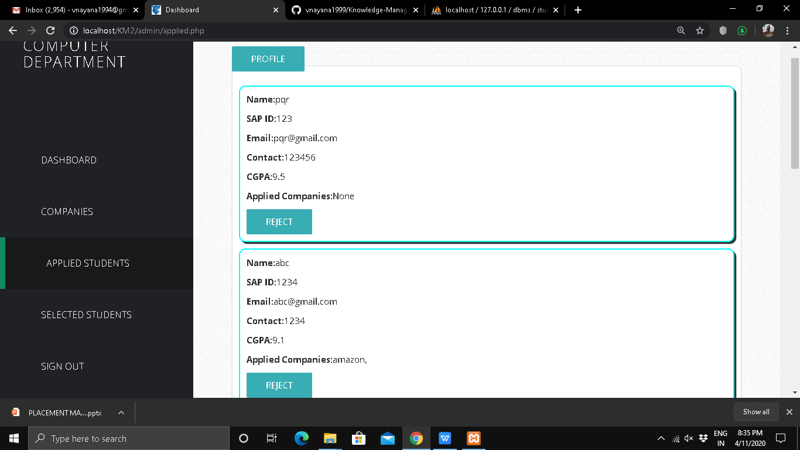

Slide 25
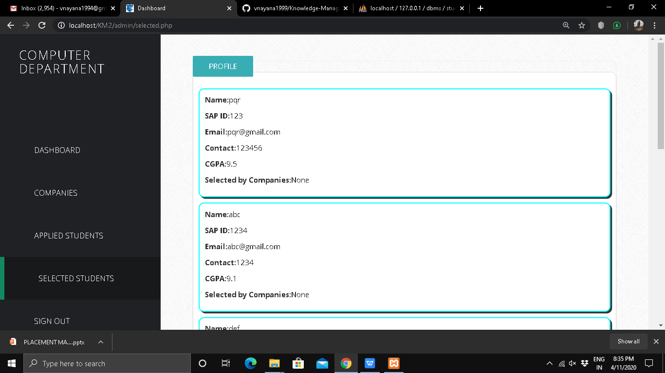

Slide 26
THANK YOU

